Slide 1
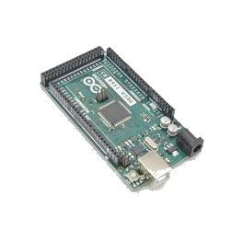
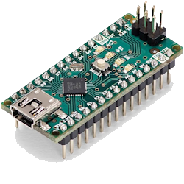
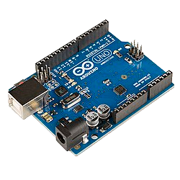
UMRT Arduino Workshop
E2-351 6pm-7:30pm 2026-04-02 Quinn Gibbons & Quinn Thiessen

Slide 2
Schedule
Arduino 101
What is the Arduino & some of it's uses
Basics of Arduino
Connecting components
Setup
Downloading the IDE
Board and Port selection
Installing Libraries
Coding 101
Basics of the Arduino IDE
Setup of setup
Important Functions
Quick Project
We will do a simple project together
Future Resources / Advice
Kits to buy & Resources for future learning
Last bits of Advice
You will have time to try your own variations

Slide 3
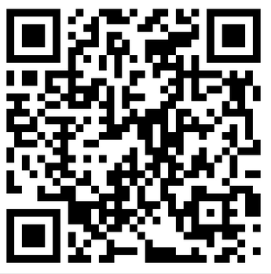
Downloading the IDE
Setup
Go to this website: https://docs.arduino.cc/software/ide/
(on your laptop)
Notes:
Laptop charged
USB type A port
Ardunio IDE installed

Slide 4

What is the Arduino?
Arduino 101
The hardware:
A variety of microcontrollers with unique functions, allowing you to connect to and control real world components.
The software:
The Arduino IDE uses a language similar to C++.
The community:
Everything is open source, meaning offbrand boards can legally be reproduced by anyone. This also means there is a massive shared library for Arduino components as a resource.

Slide 5
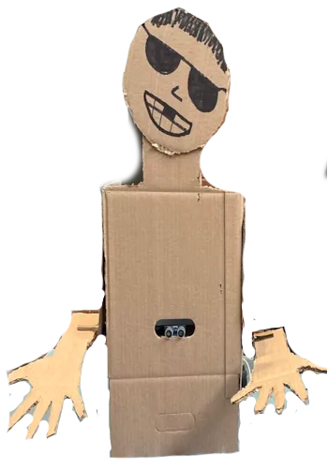
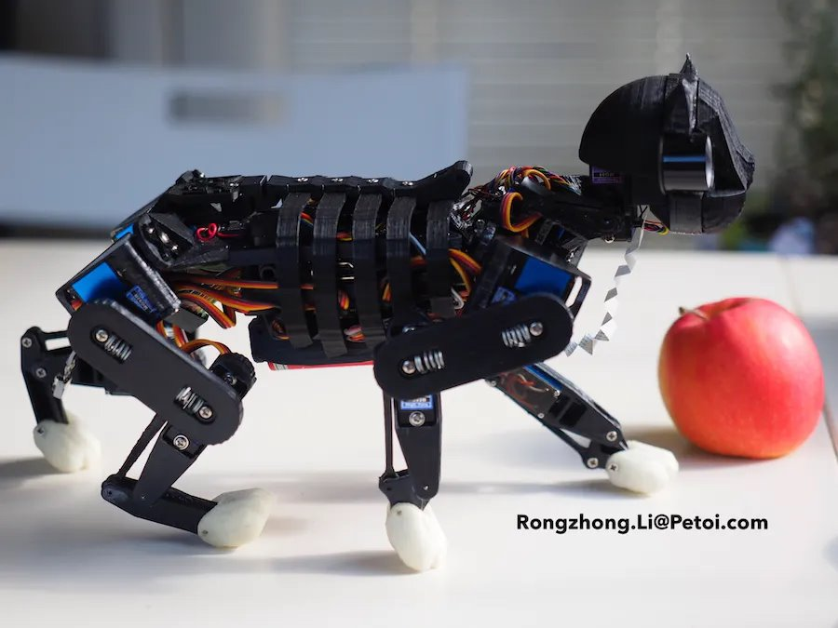
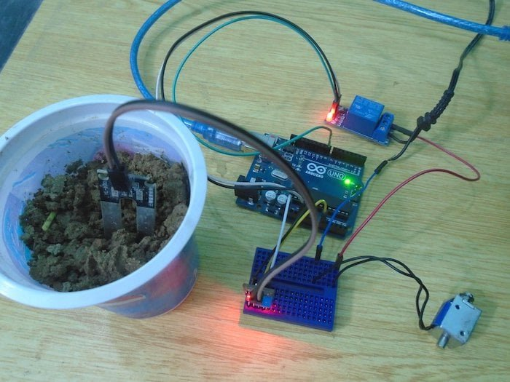
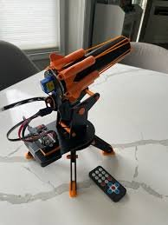

Somethings you can do...
Arduino 101

Slide 6
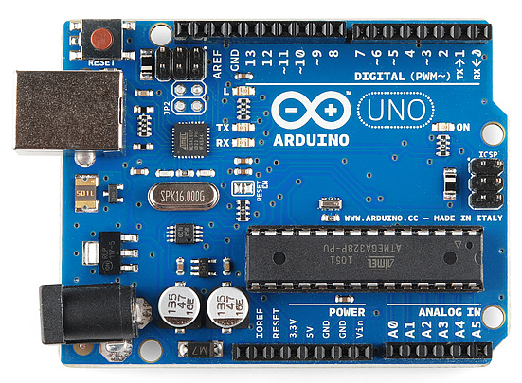
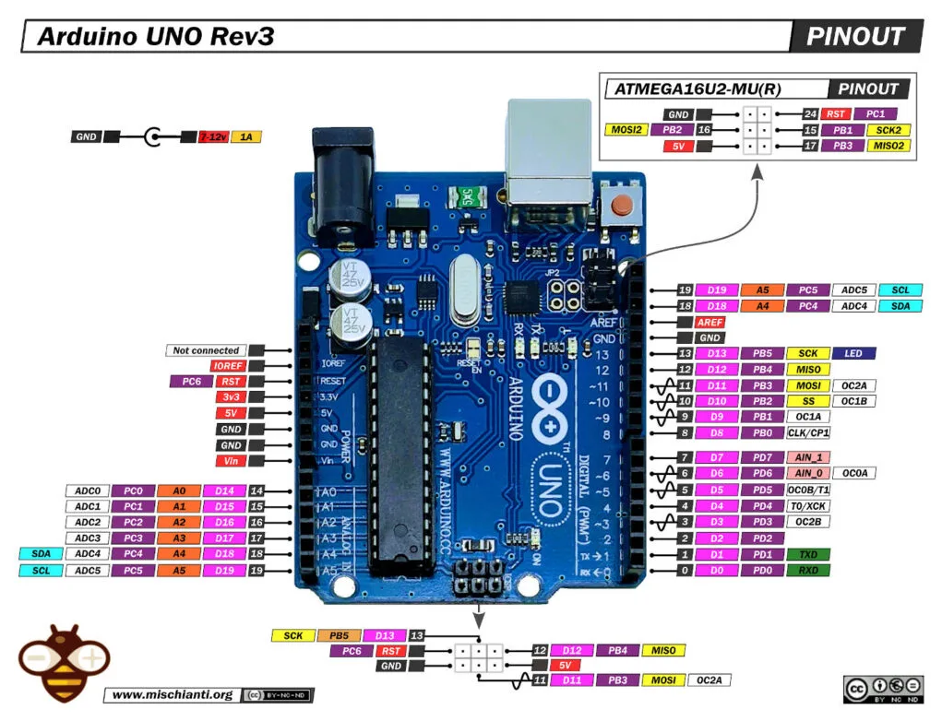
Basics of the board
Arduino 101
Digital pins
I2C Communication pins
Note: if they have a ~, they are capable of pulse width modulation (PWM)
Power pins
Reference pins
Reset pin
Analog pins

Slide 7
Powering the Arduino
Arduino 101
It is recommended to power the Arduino via USB port to your computer
USB port (5V)
DC Barrel Jack (7-12V)
Vin port (7-12V)

Slide 8
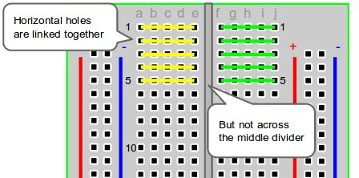
Breadboard
Arduino 101
The breadboard will allow you to build circuits without soldering.
Typically you use the long rows as power and ground
Keep in mind rows are linked horizontally, and do not cross the middle divider
There is also no connection from upper to lower rows
NOTE: If you are using motors and high power consumption components, make sure you are careful with power ratings + consumption!!!

Slide 9
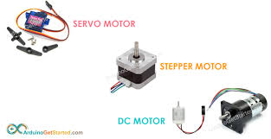
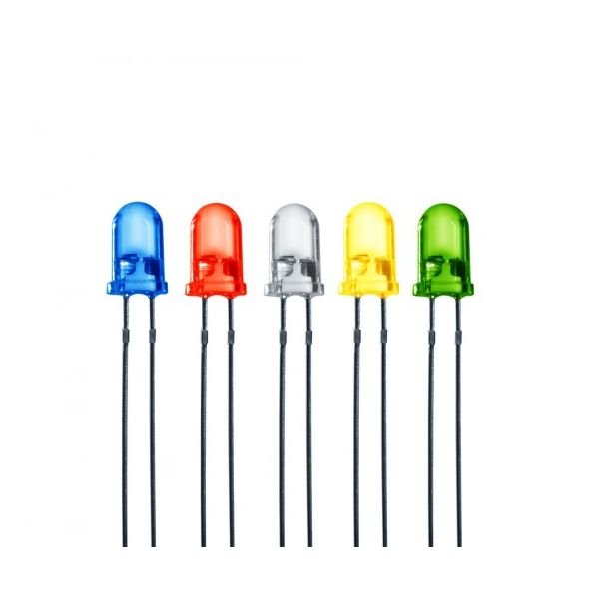
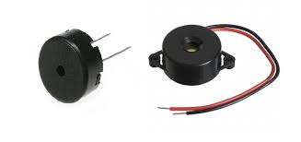
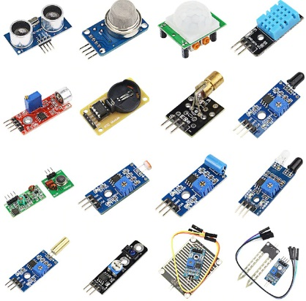
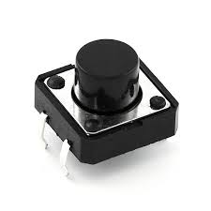
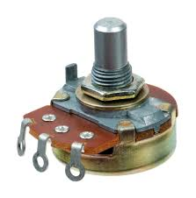
Some common components:
Arduino 101
Motors
LEDs
Buzzers
Sensors
Potentiometers / Switches / Buttons

Slide 10
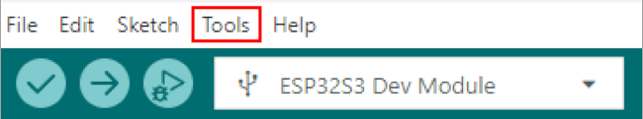
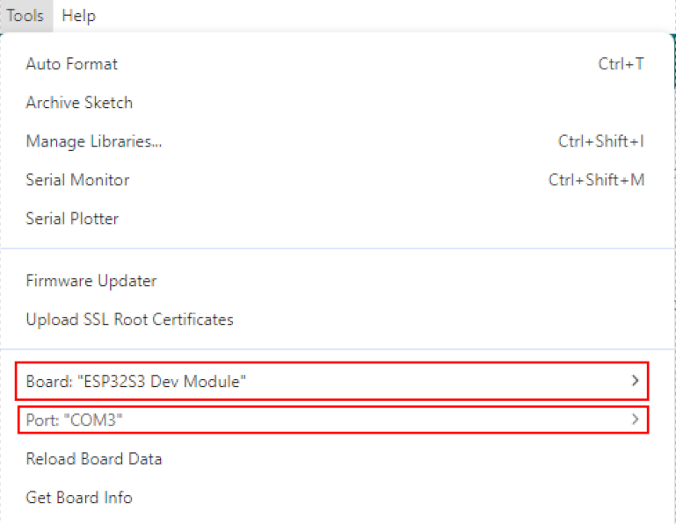
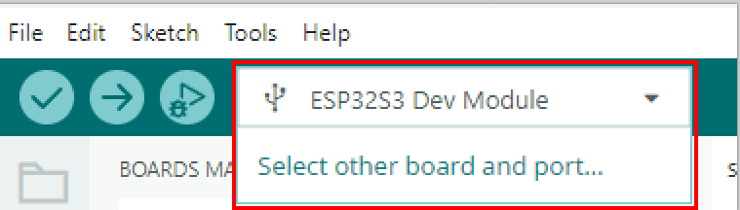
Board + Port Setup
Setup
To choose a port go to
Tools > Port > [select the port your arduino is connected to]
To choose a board go to
Tools > Board > Arduino AVR Boards > Arduino Uno
(Or alternately select both from this dropdown)

Slide 11
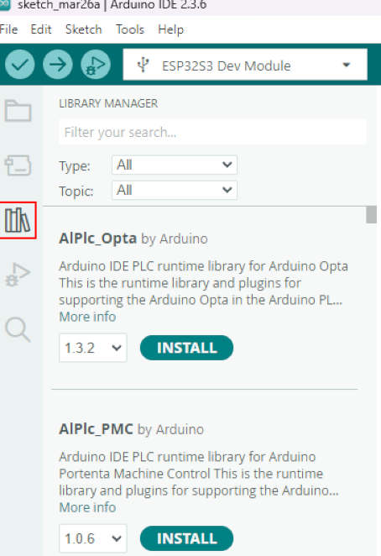
FYI: Installing Libraries
Setup
Libraries: Prebuilt code. They can provide specific functions for individual Arduino components.
You can either install zip libraries or select in the Library Manager

Slide 12
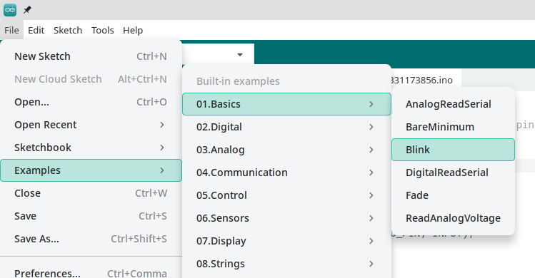
Basics of the Arduino IDE
Coding 101

Slide 13
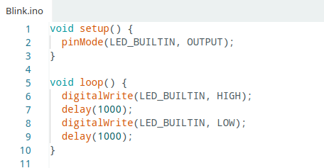
Basics of the Arduino IDE
Coding 101
The IDE uses a language similar to C++
Every program:
Setup function
Loop function
Order of execution:
Setup()
Loop()
Loop()
Loop()
…..

Slide 14
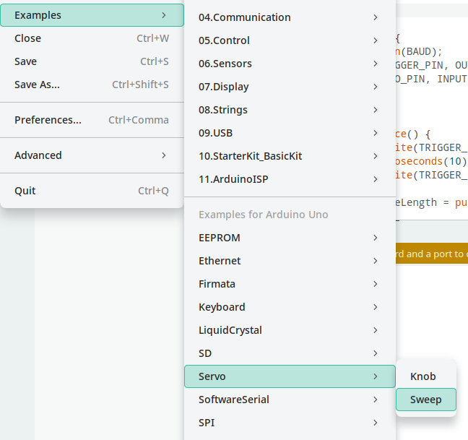
Basics of the Arduino IDE
Coding 101

Slide 15
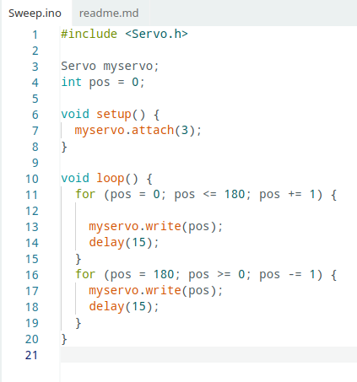
Basics of the Arduino IDE
Coding 101
Plug in servo:
Ground (Brown)
5V
Data (pin 3)
Run the code
Keep the servo plugged in

Slide 16
Questions?
Coding 101
We will be moving on to the small project next.

Slide 17
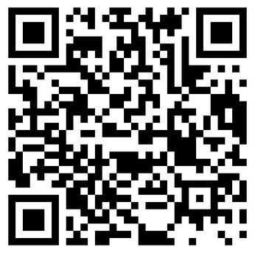
The project
The project
First, a short video about the components.
https://www.youtube.com/watch?v=KGwtit2bFyo
We will not be making the project in the video together.

Slide 18
The project (pt. 1/2): Distance detection
The project
We will start from the "Blink" example!
Connect the ultrasonic sensor
Set up Serial printing ("Hello, World")
Read and print the distance value

Slide 19
The project (pt. 2/2): Distance Controlled Motor
The project
Copy the code from 'Sweep' to set up the servo
Make sure your servo is still plugged in
Add the line of code:
myServo.write(distance)
You're done!

Slide 20
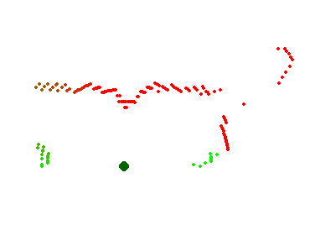
Big Example

Slide 21
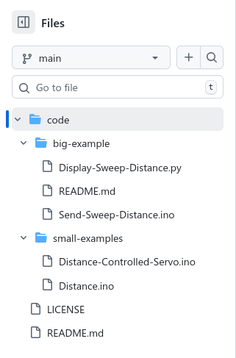
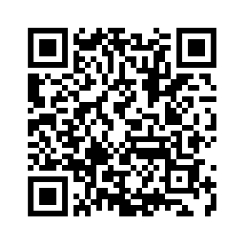
Code for all previous parts
https://github.com/UMRoboticsTeam/arduino-workshop-April-2026/

Slide 22
Short additions to this project If we have time... Try one!
The project
Easy:
Make the built-in LED turn on if the distance is close enough
If you've done that: Make an array of LEDs turn on one at a time the closer you get
Medium:
Modify the 'Sweep' code to change the speed depending on the distance
Hard:
Plug in the 'joystick' and use it to control the servo
The joystick resting position should keep the servo still
Left/right should control the servo
Note: The joystick has two potentiometers! Use analog read.

Slide 23
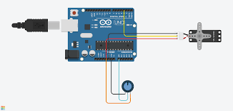
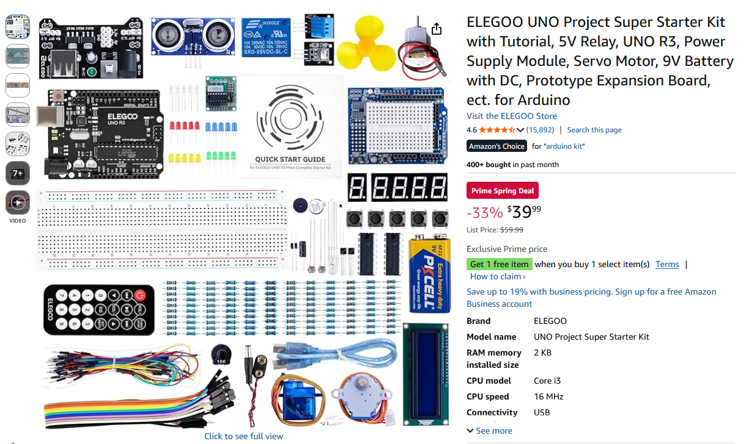

Here are some resources to help you in the future
Future resources
Tinkercad: https://www.tinkercad.com/ : Free simulation
These are some websites with premade projects:
https://projecthub.arduino.cc/
https://www.instructables.com/
Our good friend Chat
Starter kit [50$]: https://a.co/d/09PPf3wS

Slide 24
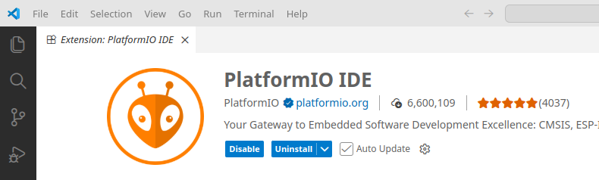
Tips from the '''expert'''
Future resources
VS Code Extension called "PlatformIO" lets you program Arduinos
This way you don't need the Arduino IDE. (look up a tutorial)
ESP32 is (basically) Arduino with WiFi/bluetooth (wireless)
If you buy pre-made sensors (like AdaFruit) they may have a library
The Arduino examples are helpful to
See the correct syntax
Straight up copy
See how to use a specific library / tool (like a servo)

Slide 25
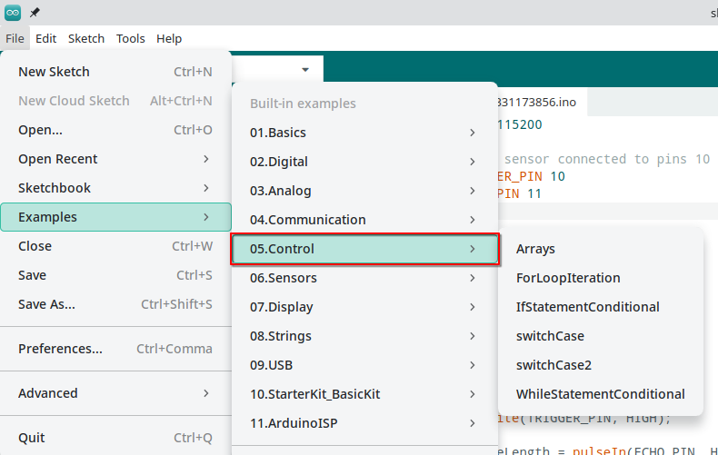
Tips from the '''expert'''
Future resources
Helpful for the language

Slide 26
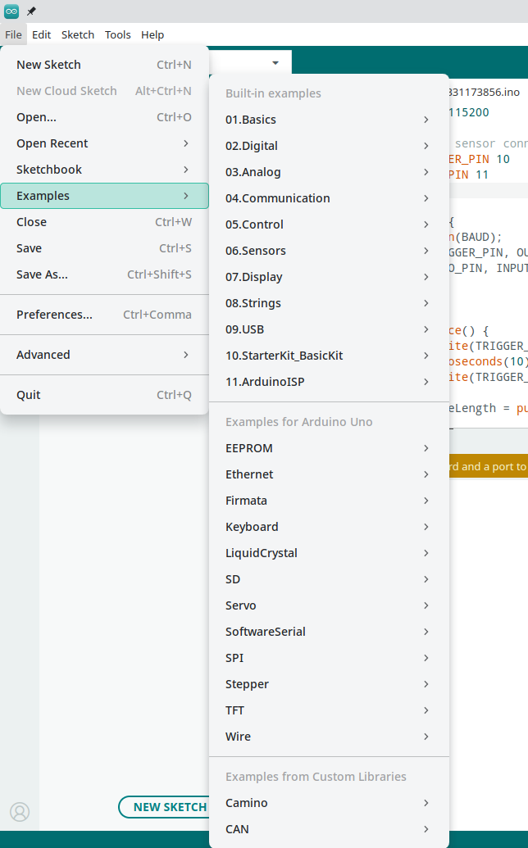
Tips from the '''expert'''
Future resources
Three categories of examples:
Built in For YOUR board For YOUR libraries
(most basic) (can be quite specific) (you install; very specific)

Slide 27


Thanks for joining us in the workshop!
If you have further questions, feel free to contact either of us on discord!!
You guys since you joined the workshop

